Slide 1
Computer Science II Advanced C++
Spring 2019

Slide 2
Arrays in C++
Compound Data Types

Slide 3
Useful Links to C++ tutorial
There are some useful hints and illustrations on arrays in C++ at
http://www.cplusplus.com/doc/tutorial/arrays/

Slide 4
Array as a data structure
An array is a data structure, which is a series of elements of the same type placed in the consecutive memory locations in such a way that each of them can be individually referenced using an index (subscript) additionally to a unique identifier of the array
Any element can easily be accessed using an array identifier and an index
A computer program needs to store only an address of the first element of an array. To access any element, a corresponding offset is calculated inside the program by multiplying the size of one element and an index of an element to be accessed

Slide 5
Arrays Hold Multiple Values
Array: variable that can store multiple values of the same type
Values are stored in adjacent memory locations
Declared using [] operator:
int tests[5]; // declaration of // the test array containing 5 // integers

Slide 6
Array - Memory Layout
The definition:
int tests[5];
allocates the following memory:
first element | second element | third element | fourth element | fifth element

Slide 7
Array Terminology
In the definition int tests[5];
int is the data type of the array elements
tests is the name of the array
5, in [5], is the size declarator. It shows the number of elements in the array.
The size of an array is (number of elements) * (size of each element)

Slide 8
Array Terminology
The size of an array is:
the total number of bytes allocated for it
(number of elements) * (number of bytes for each element)
Examples:
int tests[5] is an array of 20 bytes, assuming 4 bytes for an int
long double measures[10]is an array of 80 bytes, assuming 8 bytes for a long double

Slide 9
Size Declarators
Named constants are commonly used as size declarators. const int SIZE = 5; int tests[SIZE];
This eases program maintenance when the size of the array needs to be changed.

Slide 10
What is an Array?
In C++, the first element in an array is always indexed with 0 (zero) (not one !!!), no matter its length. Hence the last element’s index is n-1 where n is the number of elements in the array
How to represents array elements?
Use a name of an array and the index of a particular element in the array
Example:
Andrew[0]
21
99
230
50
37
Andrew[1]
Name of the array
Andrew[2]
Andrew[3]
Index of an element
Andrew[4]

Slide 11
What is an Array?
The use of arrays make it possible to reduce the amount of coding to a minimum, especially if the same operation shall be applied to all elements of an array
Suppose we want to use 5 properties characterized by the following integers
int number_1, number_2, number_3, number_4, number_5;
number_1=54;
number_2=26;
number_3=99;
number_4= -25;
number_5=13;
The same properties can easily be determined using an array:
int number[5] = { 54, 26, 99, -25, 13 };

Slide 12
Defining Array in C++
Syntax of Array:
for one dimensional array
Data_type_in_array array_name [number of elements]; Data_type_in_array array_name [number of elements] = {element1, element2,…};
The elements in an array can be explicitly initialized to specific values when it is declared, by enclosing those initial values in braces {}
When an initialization of values is provided for an array, C++ allows the possibility of leaving the square brackets empty []. In this case, the compiler will assume automatically a size for the array that matches the number of values included between the braces {}

Slide 13
Defining Array in C++
Examples:
int c[12]
int b[100], x[27];
int numbers[5];
int number[5] = { 54, 26, 99, -25, 13 };
int number[] = { 54, 26, 99, -25, 13 };
int number[5] = {}; // initializes an array containing 5 // zeros
Storing value in specific location in Array:
numbers[0] = 54;
numbers[1] = 26;

Slide 14
Default Initialization
Global array → all elements initialized to 0 by default
Local array → all elements uninitialized by default

Slide 15
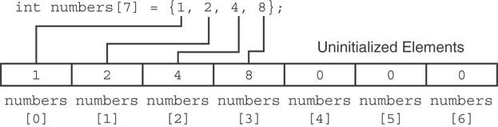
Partial Array Initialization
If array is initialized with fewer initial values than the size declarator, the remaining elements will be set to 0:

Slide 16
Implicit Array Sizing
Can determine array size by the size of the initialization list:
int quizzes[]={12,17,15,11};
Must use either array size declarator or initialization list at array definition
12 | 17 | 15 | 11

Slide 17
Accessing Array Elements
Array elements can be used as regular variables:
tests[0] = 79;
cout << tests[0];
cin >> tests[1];
tests[4] = tests[0] + tests[1];
Arrays must be accessed via individual elements:
cout << tests; // not legal

Slide 18
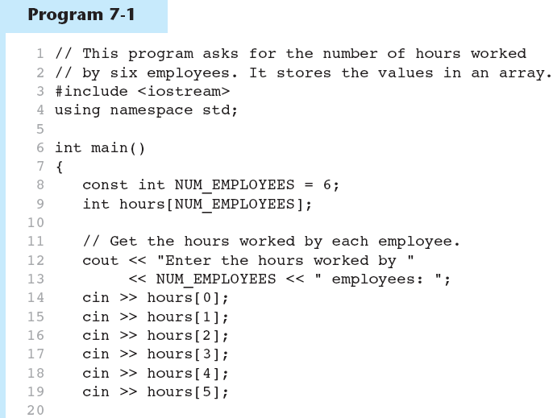
Accessing Array Elements in Program 7-1
(Program Continues)

Slide 19
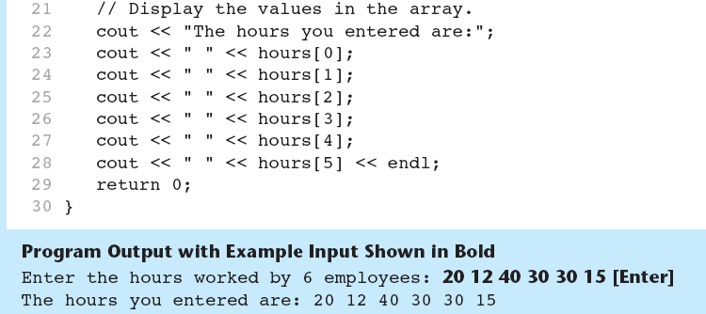
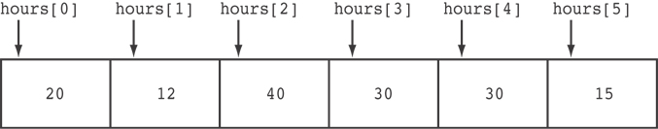
Accessing Array Elements in Program 7-1
Here are the contents of the hours array, with the values entered by the user in the example output:

Slide 20
Using a Loop to Step Through an Array
Example – The following code defines an array, numbers, and assigns 99 to each element:
const int ARRAY_SIZE = 5;
int numbers[ARRAY_SIZE];
for (int count = 0; count < ARRAY_SIZE; count++)
numbers[count] = 99;

Slide 21
Example 1
#include <iostream>
using namespace std;
int main()
{
int i;
int hello[5];
hello[0] = 12;
hello[1] = 20;
hello[2] = 100;
hello[3] = 77;
hello[4] = 54;
for(i = 0; i < 5; i++)
cout << hello[i] << ‘\n’;
return 0;
}
#include <iostream>
using namespace std;
int main()
{
int i;
int hello[5] = {12, 20, 100, 77, 44};
for(i = 0; i < 5; i++)
cout << hello[i] << ‘\n’;
return 0;
}
Run:
12
20
100
77
54

Slide 22
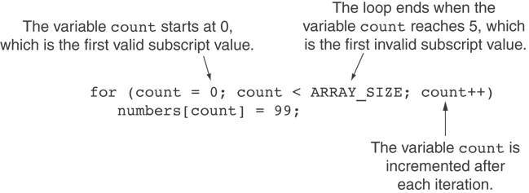
A Closer Look At the Loop

Slide 23
Example 2- displaying array elements before and after initialization
Run:
before initializing the array
0 0
1 0
2 0
3 4286192
4 2686672
5 2686728
6 2686916
7 1994362069
8 388492688
9 -2
-----------------------------
Element Value
0 0
1 0
2 0
3 0
4 0
5 0
6 0
7 0
8 0
9 0
#include <iostream>
using namespace std;
int main()
{
int hello[10];
int i;
cout <<"\tbefore initializing the array"<<endl;
for(i = 0; i < 10; i++)
{
cout<<"\t"<<i<<"\t\t"<<n[i]<<"\n";
}
cout<<"\t-----------------------------";
cout<<endl;
for(i = 0; i < 10; i++) {
hello[i] = 0;
}
cout<<"\tElement\t\tValue"<<endl;
for(i = 0; i < 10; i++)
{
cout<<"\t"<<i<<"\t\t << hello[i]<<"\n";
}
return 0;
}

Slide 24
Example 3 – assigning values to the array elements in a loop
#include <iostream>
using namespace std;
int main(void)
{
int i;
int hello[10];
for(i = 0; i < 10; i++)
{
hello[i] = i+1;
}
cout<<"\tIndex\t\tValue"<<endl;
for(i = 0; i < 10; i++)
{
cout<<"\t"<<i<<"\t\t << hello[i]<<"\n";
}
return 0;
}
Run:
Index Value
0 1
1 2
2 3
3 4
4 5
5 6
6 7
7 8
8 9
9 10

Slide 25
Example 4 – initialization of the array elements values using { }
#include <iostream>
using namespace std;
int main()
{
int i;
int hello[10] = {32, 27, 64, 18, 95, 14, 90, 70, 60, 37};
cout<<"\tIndex\t\tValue"<<endl;
for(i = 0; i < 10; i++)
{
cout<<"\t"<<i<<"\t\t << hello[i]<<"\n";
}
return 0;
}
Run:
Index Value
0 32
1 27
2 64
3 18
4 95
5 14
6 90
7 70
8 60
9 37

Slide 26
Example 5 – displaying of even numbers from 0 to 20
#include <iostream>
using namespace std;
int main(void)
{
int i, j;
int hello[11];
j = 0;
for(i = 0; i <= 10; i++)
{
hello[i] = j;
j+=2;
}
cout<<"\tElement\t\tValue"<<endl;
for(i = 0; i <= 10; i++)
{
cout<<"\t"<<i<<"\t\t" << hello[i]<<"\n";
}
return 0;
}
Run:
Element Value
0 0
1 2
2 4
3 6
4 8
5 10
6 12
7 14
8 16
9 18
10 20

Slide 27
Exercise 1
Write a program that stores all odd numbers from 1 to 21 to the array and then adds all array values

Slide 28
No Bounds Checking in C++
When you use a value as an array subscript, C++ does not check it to make sure it is a valid subscript
In other words, you can use subscripts that are beyond the bounds of the array

Slide 29
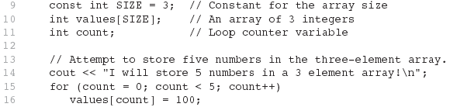
Code From Program 7-5
The following code defines a three-element array, and then writes five values to it!

Slide 30
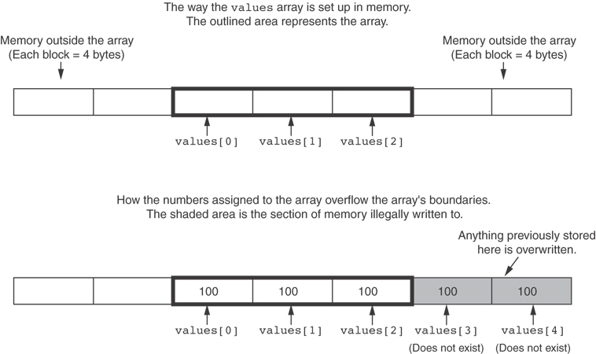
What the Code Does

Slide 31
No Bounds Checking in C++
Be careful not to use invalid indexes (subscripts)!
Doing so can corrupt other memory locations, crash program, or lock up computer, and cause elusive bugs.

Slide 32
7.6
Processing Array Contents

Slide 33
Processing Array Contents
Array elements can be treated as ordinary variables of the same type as the array
When using ++, -- operators, don’t confuse the element with the subscript:
tests[i]++; // add 1 to tests[i]
tests[i++]; // increment i, no
// effect on tests

Slide 34
Array Assignment
To copy one array to another,
Don’t try to assign one array to the other:
newTests = tests; // Won't work
Instead, assign element-by-element:
for (i = 0; i < ARRAY_SIZE; i++)
newTests[i] = tests[i];

Slide 35
Printing the Contents of an Array
You can display the contents of a character array by sending its name to cout: char fName[] = "Henry";
cout << fName << endl;
But, this ONLY works with character arrays!

Slide 36
Printing the Contents of an Array
For other types of arrays, you must print element-by-element:
for (i = 0; i < ARRAY_SIZE; i++)
cout << tests[i] << endl;

Slide 37
Summing and Averaging Array Elements
Use a simple loop to add together array elements:
int tnum;
double average, sum = 0;
for(tnum = 0; tnum < SIZE; tnum++)
sum += tests[tnum];
Once summed, can compute average:
average = sum / SIZE;

Slide 38
Summing and Averaging Array Elements
In C++ 11 you can use the range-based for loop, as shown here:
double total = 0; // Initialize accumulator
double average; // Will hold the average
double scores[]={1,2,3,4,5};
for (int val : scores)
total += val;
average = total / NUM_SCORES;

Slide 39
Finding the Highest Value in an Array
int count;
int highest;
highest = numbers[0];
for (count = 1; count < SIZE; count++)
{
if (numbers[count] > highest)
highest = numbers[count];
}
When this code is finished, the highest variable will contains the highest value in the numbers array.

Slide 40
Finding the Lowest Value in an Array
int count;
int lowest;
lowest = numbers[0];
for (count = 1; count < SIZE; count++)
{
if (numbers[count] < lowest)
lowest = numbers[count];
}
When this code is finished, the lowest variable will contains the lowest value in the numbers array.

Slide 41
Partially-Filled Arrays
If it is unknown how much data an array will be holding:
Make the array large enough to hold the largest expected number of elements (this does not work for multi-dimensional arrays!)
Use a counter variable to keep track of the number of items stored in the array

Slide 42
Comparing Arrays
To compare two arrays, you must compare element-by-element:
const int SIZE = 5;
int firstArray[SIZE] = { 5, 10, 15, 20, 25 };
int secondArray[SIZE] = { 5, 10, 15, 20, 25 };
bool arraysEqual = true; // Flag variable
int count = 0; // Loop counter variable
// Compare the two arrays.
while (arraysEqual && count < SIZE)
{
if (firstArray[count] != secondArray[count])
arraysEqual = false;
count++;
}
if (arraysEqual)
cout << "The arrays are equal.\n";
else
cout << "The arrays are not equal.\n";

Slide 43
Linear search
#include <iostream>
using namespace std;
int main()
{
int searchingKey;
int numbers[10]={1,2,3,4,5,6,7,8,9,10};
cout<<"Enter searching key (1 - 10): ";
cin>>searchingKey;
int i;
for(i = 0; i < 10; i++)
{
if(searchingKey == numbers[i])
{
cout << searchingKey << " is found at << "numbers[“ << i << "]"
<<endl;
break; // exit from the loop if the key was found
}
}
return 0;
}
Run:
Enter searching key (1 - 10): 7
7 is found at numbers[6]

Slide 44
7.5
The Range-Based for Loop

Slide 45
The Range-Based for Loop
C++ 11 provides a specialized version of the for loop that, in many circumstances, simplifies array processing.
The range-based for loop is a loop that iterates once for each element in an array.
Each time the loop iterates, it copies an element from the array to a built-in variable, known as the range variable.
The range-based for loop automatically knows the number of elements in an array.
You do not have to use a counter variable.
You do not have to worry about stepping outside the bounds of the array.

Slide 46
The Range-Based for Loop
Here is the general format of the range-based for loop:
dataType is the data type of the range variable.
rangeVariable is the name of the range variable. This variable will receive the value of a different array element during each loop iteration.
array is the name of an array on which you wish the loop to operate.
statement is a statement that executes during a loop iteration. If you need to execute more than one statement in the loop, enclose the statements in a set of braces.
for (dataType rangeVariable : array)
statement;

Slide 47
The range-based for loop in Program 7-10
// This program demonstrates the range-based for loop. #include <iostream> using namespace std; int main() { // Define an array of integers. int numbers[] = { 10, 20, 30, 40, 50 }; // Display the values in the array. for (int val : numbers) cout << val << endl; return 0; }

Slide 48
Printing the Contents of an Array
In C++ 11 you can use the range-based for loop to display an array's contents, as shown here:
for (int val : numbers)
cout << val << endl;

Slide 49
Modifying an Array with a Range-Based for Loop
As the range-based for loop executes, its range variable contains only a copy of an array element.
You cannot use a range-based for loop to modify the contents of an array unless you declare the range variable as a reference.
To declare the range variable as a reference variable, simply write an ampersand (&) in front of its name in the loop header.
Program 7-12 demonstrates

Slide 50
Modifying an Array with a Range-Based for Loop in Program 7-12
const int SIZE = 5; int numbers[5]; // Get values for the array. for (int &val : numbers) { cout << "Enter an integer value: "; cin >> val; } // Display the values in the array. cout << "Here are the values you entered:\n"; for (int val : numbers) cout << val << endl;

Slide 51
Modifying an Array with a Range-Based for Loop
You can use the auto key word with a reference range variable. For example, the code in lines 12 through 16 in Program 7-12 could have been written like this:
for (auto &val : numbers)
{
cout << "Enter an integer value: ";
cin >> val;
}

Slide 52
The Range-Based for Loop versus the Regular for Loop
The range-based for loop can be used in any situation where you need to step through the elements of an array, and you do not need to use the element subscripts.
If you need the element subscript for some purpose, use the regular for loop.

Slide 53
Exercise 2
Modify a program from the Exercise 1 using a range-based for loop for funding a sum of all array values. Thus, write a program that stores all odd numbers from 1 to 21 to the array and then use a range-based for loop to add all array values in

Slide 54
Arrays and Functions
C++ does not support return of an array from functions. If it is necessary to return an array from a function, then a pointer to this array (to its first element) shell be returned (we will consider this later along with pointers)
Contrary, if we need to pass an array or its element as a parameter to a function, this can be done pretty easily

Slide 55
Arrays as Function Arguments
To pass an array to a function, just use the array name:
showScores(tests); // the showScores //function accepts the tests array as a //parameter
To define a function that takes an array parameter, use empty [] for array argument:
void showScores(int []);
// function prototype
void showScores(int tests[])
// function header

Slide 56
Arrays as Function Arguments
When passing an array to a function, it is common to pass array size so that function knows how many elements to process:
showScores(tests, ARRAY_SIZE);
Array size must also be reflected in prototype, header:
void showScores(int [], int);
// function prototype
void showScores(int tests[], int size)
// function header

Slide 57
Passing an array to a Function
Passing an entire array:
Function_name (array_name, ARRAY_SIZE);// // ARRAY_SIZE must be determined earlier as // integer
Function_name (array_type [], int size); // //size is declared right in the array //definition
Call by reference
Called functions can modify the elements of an array

Slide 58
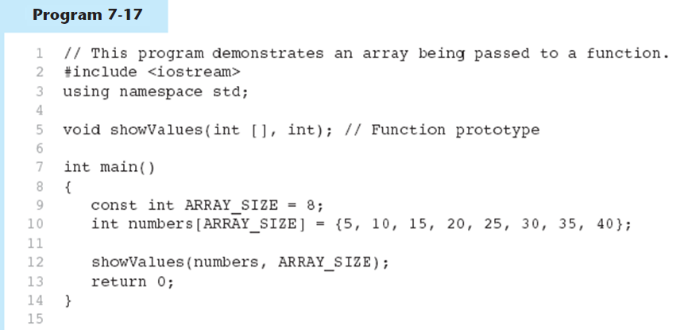
Passing an Array to a Function in Program 7-17
(Program Continues)

Slide 59
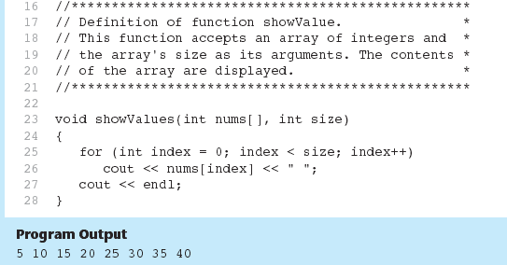
Passing an Array to a Function in Program 7-17

Slide 60
Passing an array to a Function
#include <iostream>
using namespace std;
void modifyArray(int b[], int size); //prototype
constant int SIZE = 5; // global constant
int main()
{
int a [SIZE] = {0,1,2,3,4};
int i;
cout << "Effects of passing entire array by reference:\n\nThe values of original array are:\n";
for(i = 0; i < SIZE; i++)
cout << a[i] << "\n";
modifyArray(a, SIZE); //calls the //modifyArray function and passes the a array //there by reference
cout << "The value of the modified array are:\n";
for(i = 0; i < SIZE; i++) //output //modified array
cout << a[i] << "\n";
return 0;
}
// function definition
void modifyArray(int b[], int size)
{
int j;
// multiply each array element by 2
for(j = 0; j < size; j++)
b[j] *=2;
}
size is a formal input parameter
SIZE is an actual calling parameter
They are not the same!!!
Run:
Effects of passing entire array by reference:
The values of original array are:
0 1 2 3 4
The value of the modified array are:
0 2 4 6 8

Slide 61
Strings in C++
Strings are, in fact, sequences of characters, we can represent them also as plain arrays of elements of a character type
By convention, the end of strings represented in character sequences is signaled by a special character: the null character, whose literal value can be written as '\0' (backslash, zero)

Slide 62
Salary Survey Application
A company pays its sales staff on a commission basis. Each member of the sales staff receives $200 per week, plus 9% of their gross sales for that week. For example, a salesperson who grosses $5000 in sales in a week receives $200 plus 9% of $5000, a total of $650.
Write an application(using an array) to determine how many of the sales staff earned salaries in each of the following ranges (assuming that each person’s salary is truncated to an integer amount): $200-$299, $300-$399, $400-$499, $500-$599, $600-$699, $700-$799, $800-$899, and over $999

Slide 63
Basic Pseudocode
Prompt the user for the first sales figure
While the sales figure is greater than or equal to zero
Calculate the salary based on commission
Increment the number of salaries within that range
Prompt the user for the next sales figure
Display the distribution of salaries

Slide 64
Program Implementation
Run:
Enter sales amount for sales person ID 1: $5000
Total Salary Amount for ID 1: $650
Do you have more to calculate? (0=yes, -1=no):0
Enter sales amount for sales person ID 2: $6000
Total Salary Amount for ID 2: $740
Do you have more to calculate? (0=yes, -1=no):0
Enter sales amount for sales person ID 3: $4000
Total Salary Amount for ID 3: $560
Do you have more to calculate? (0=yes, -1=no):-1
Salary range is as follows:
$200 - $299: 0
$300 - $399: 0
$400 - $499: 0
$500 - $599: 1
$600 - $699: 1
$700 - $799: 1
$800 - $899: 0
Over $900: 0

Slide 65
Multi-dimensional arrays
Multidimensional arrays can be described as "arrays of arrays"
For example, a bidimensional array can be imagined as a two-dimensional table made of elements, all of them of a same uniform data type
Multidimensional arrays are not limited to two indices (i.e., two dimensions). They can contain as many indices as needed. Although be careful: the amount of memory needed for an array increases exponentially with each dimension

Slide 66
Multi-Dimensional Arrays
Multi-dimensional array
Represent tables of values consisting of information arranged in rows and columns.
a[3][4] means it has three rows and four columns.
 | Column 0 | Column 1 | Column 2 | Column 3
Row 1 | a[0][0] | a[0][1] | a[0][2] | a[0][3]
Row 1 | a[1][0] | a[1][1] | a[1][2] | a[1][3]
Row 2 | a[2][0] | a[2][1] | a[2][2] | a[2][3]
Column index
Row index
Array Name

Slide 67
Two-Dimensional Arrays
Can define one array for multiple sets of data
Like a table in a spreadsheet
Use two size declarators in definition:
const int ROWS = 4, COLS = 3; int exams[ROWS][COLS];
First declarator is number of rows; second is number of columns

Slide 68
Two-Dimensional Array Representation
const int ROWS = 4, COLS = 3; int exams[ROWS][COLS];
Use two subscripts to access element:
exams[2][2] = 86;
columns
exams[0][0] | exams[0][1] | exams[0][2]
exams[1][0] | exams[1][1] | exams[1][2]
exams[2][0] | exams[2][1] | exams[2][2]
exams[3][0] | exams[3][1] | exams[3][2]
r
o
w
s

Slide 69
Multi-dimensional arrays
double Example [10] [15]
declares a 2D array Example containing 10x15 double floating point numbers (can be considered as 10 x 15 matrix)
int Example1 [5] [10] [7]
declares a 3D array example containing 10x15x7 integer numbers

Slide 70
2D Array Initialization
Two-dimensional arrays are initialized row-by-row: const int ROWS = 2, COLS = 2; int exams[ROWS][COLS] = { {84, 78},
{92, 97} };
Can omit inner { }, some initial values in a row – array elements without initial values will be set to 0 or NULL
84 | 78
92 | 97

Slide 71
Initializing two-dimensional array
int numbers[3][2];
numbers[0][0] = 1;
numbers[0][1] = 2;
numbers[1][0] = 3;
numbers[1][1] = 4;
numbers[2][0] = 5;
numbers[2][1] = 6;
 | Column 0 | Column 1
Row 0 | 1 | 2
Row 1 | 3 | 4
Row 2 | 5 | 6

Slide 72
Initializing two-dimensional array
int b[2][2] = { {1,2}, {3,4} };
int b[2][2] = { {1}, {3,4} };
int b[2][3] = {1,2,3,4,5};
Int b[2][3] = { {1,2},{4} };
 | Column 0 | Column 1
Row 0 | 1 | 2
Row 1 | 3 | 4
 | Column 0 | Column 1 | Column 2
Row 0 | 1 | 2 | 3
Row 1 | 4 | 5 | 0
 | Column 0 | Column 1
Row 0 | 1 | 0
Row 1 | 3 | 4
 | Column 0 | Column 1 | Column 2
Row 0 | 1 | 2 | 0
Row 1 | 4 | 0 | 0

Slide 73
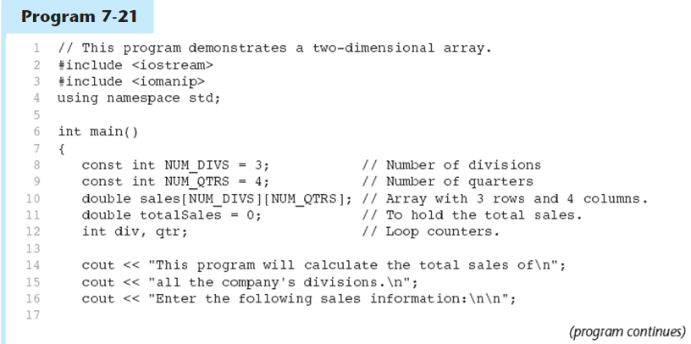
A Two-dimensional Array in Program 7-21

Slide 74
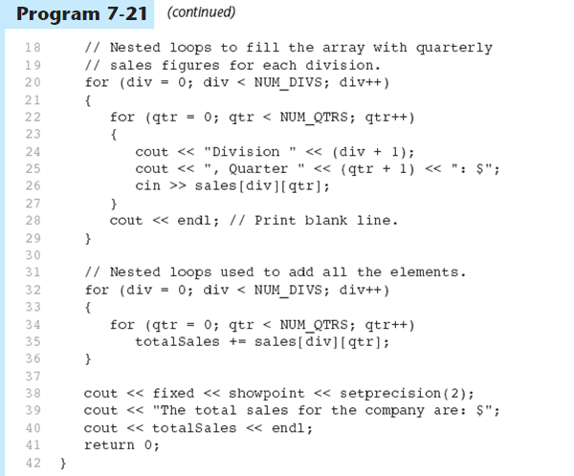
A Two-dimensional Array in Program 7-21

Slide 75
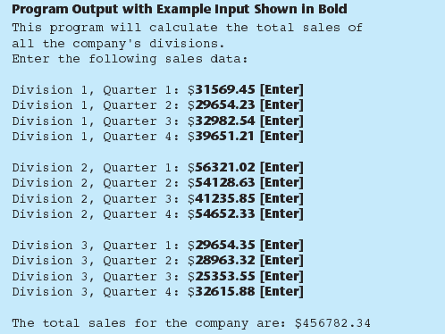
A Two-dimensional Array in Program 7-21

Slide 76
Two-Dimensional Array as Parameter, Argument
Use array name as argument in function call:
getExams(exams, 2);
Use empty [] for row, size declarator for column in prototype, header: const int COLS = 2; // Prototype void getExams(int [][COLS], int); // Header void getExams(int exams[][COLS], int rows)

Slide 77
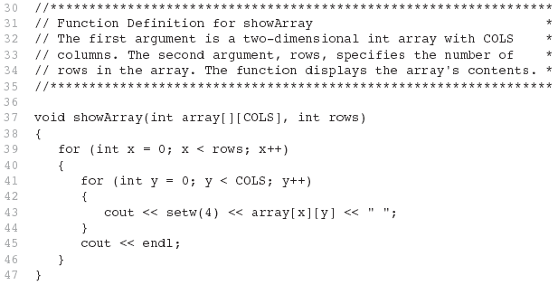
Example – The showArray Function from Program 7-22

Slide 78
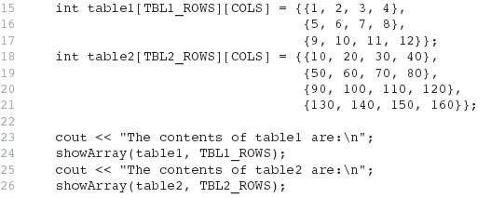
How showArray is Called

Slide 79
Display each value
Run:
row 0 and column 0: 1
row 0 and column 1: 2
row 0 and column 2: 3
row 1 and column 0: 4
row 1 and column 1: 5
row 1 and column 2: 6
#include <iostream>
using namespace std;
int main()
{
//Define 2-D array and assign values using initializer
int numbers[2][3]={{1,2,3},{4,5,6}};
//display values from each element of an array
cout << "row 0 and column 0: "<<numbers[0][0] << "\n";
cout << "row 0 and column 1: "<<numbers[0][1] << "\n";
cout << "row 0 and column 2: "<<numbers[0][2] << "\n";
cout << "row 1 and column 0: "<<numbers[1][0] << "\n";
cout << "row 1 and column 1: "<<numbers[1][1] << "\n";
cout << "row 1 and column 2: "<<numbers[1][2] << "\n";
return 0;
}

Slide 80
Using loop(nested loop)
#include <iostream>
using namespace std;
int main()
{
//define a two dimensional array
int numbers[2][3];
//assign a value in each element in an array using loop
for(int i = 0; i < 2; i++)
for(int j = 0; j < 3; j++)
{
if(i == 0)
numbers[i][j] = j+1;
else
numbers[i][j] = j+4;
}
cout << "\n“ << endl;
//make sure that values from 1 to 6 are assigned in each element in an array
for(int i = 0; i < 2; i++)
for(int j = 0; j < 3; j++)
cout << numbers[i][j] << "\t";
cout << endl;
return 0;
}
Run:
1 2 3 4 5 6

Slide 81
Add all values by rows and columns
#include <iostream>
using namespace std;
int main()
{
//define 2-D array and store values
int numbers[2][3] = {{1,2,3},{4,5,6}};
int total1;
int total2;
//add all numbers by rows
for(int i = 0; i < 2; i++)
{
total1 = 0;
for(int j = 0; j < 3; j++)
{
total1 += numbers[i][j];
}
cout << "Total 1: "<< total1 << endl;
}
cout << endl;
//add all numbers by columns
for(int i = 0; i < 3; i++)
{
total2 = 0;
for(int j = 0; j < 2; j++)
{
total2 += numbers[j][i];
}
cout << "Total 2: "<< total2 << endl;
}
return 0;
}
Run:
Total 1: 6
Total 1: 15
Total 2: 5
Total 2: 7
Total 2: 9

Slide 82
Passing two-dimensional arrays to a function
Pass the array name itself as an argument
In a function definition, the number of rows is not required, but the size of column is necessary to use as a parameter
Example:
const int size = 10;
const int test = 5;
int good [test][size] = {0};
process2DArray(good);
void process2DArray(int hello [] [size]);

Slide 83
Two-Dimensional Array as Parameter, Argument
Use array name as argument in function call:
getExams(exams, 2);
Use empty [] for row, size declarator for column in prototype, header: const int COLS = 2; // Prototype void getExams(int [][COLS], int); // Header void getExams(int exams[][COLS], int rows)

